Slide 1
CHURNING OF CRIDIT CARD CUSTOMERS DATASET
-BY AKHILESH MISHRA

Slide 2
WHAT IS DATASET?
“A dataset (or data set) is a collection of data, usually presented in tabular form. Each column represents a particular variable. Each row corresponds to a given member of the dataset in question. It lists values for each of the variables, such as height and weight of an object. Each value is known as a datum.
Data are observations or measurements (unprocessed or processed) represented as text, numbers, or multimedia. A dataset is a structured collection of data generally associated with a unique body of work.

Slide 3
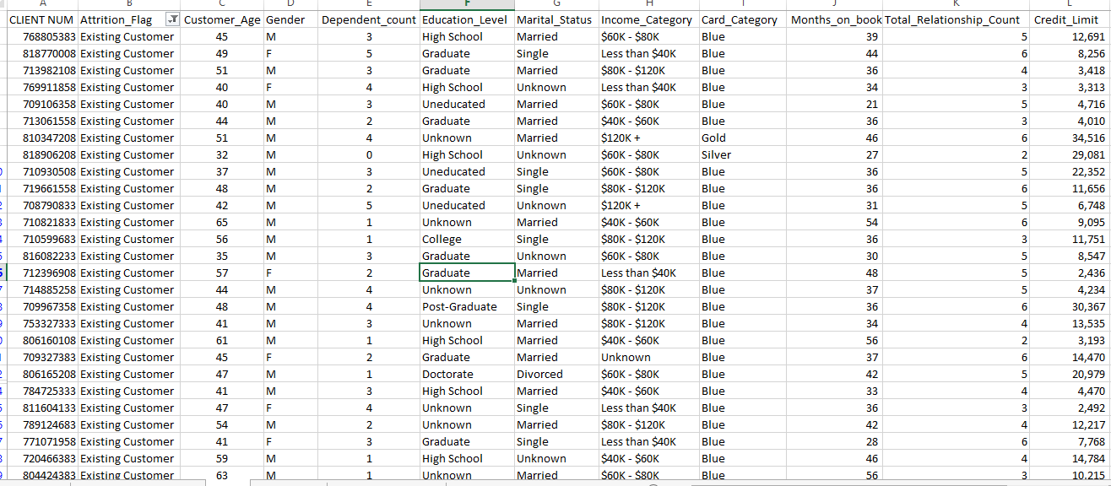
DATA SET LIKE THIS WHICH IS MENTIONED BELOW IN EXCEL FILE

Slide 4
Question and Answer of this data set
Q1) Total transactions of amounts? 446,00,182
Q2) Total top 6 transactions? 1,06,983
Q3) Total credit limit by the cards? 874,15,795
Q4) Highest card limit ? blue 694,84,628
Q5)Total Existing customers? 8,500
Q6) Total Attired customers? 1,627
Q7) Total Female customers? 5,358
Q8)Total Male customers? 4,769
Q10) Total No of Uneducated Customers ? 1,487
Q11)Total unknown Educated customers? 1,519
Q12) Total educated customers? 7,121
Q13) Top Highest transaction customer? 718140783 18,484

Slide 5
Top 6 Transaction
Row Labels | Sum of Total_Trans_Amt
719694408 | 7,996
714361083 | 5,843
711742758 | 5,242
791730183 | 5,070
711736083 | 4,885
718732833 | 3,967
Grand Total | 33,003

Slide 6
No of attired and Existing customers
No of customers | count in nos.
Attired customers | 1,627
Existing customers | 8,500

Slide 7
Education Of Customers
Row Labels | Distinct Count of CLIENT NUM
Graduate | 3,128
High School | 2,013
Unknown | 1,519
Uneducated | 1,487
College | 1,013
Post-Graduate | 516
Doctorate | 451
Grand Total | 10,127

Slide 8
Total credit Limits
Row Labels | Sum of Credit_Limit
Blue | 694,84,628
Gold | 32,96,299
Platinum | 6,05,669
Silver | 140,29,199
Grand Total | 874,15,795

Slide 9
Males & Females
Row Labels | Distinct Count of CLIENT NUM
F | 5,358
M | 4,769
Grand Total | 10,127

Slide 10
Senior Citizens
Row Labels | Sum of Customer_Age
715952883 | 73
787348608 | 70
712720158 | 68
708868233 | 68
717916758 | 67
779241783 | 67
778286433 | 67
717296808 | 67
711525033 | 66
708300483 | 66
Grand Total | 679

Slide 11
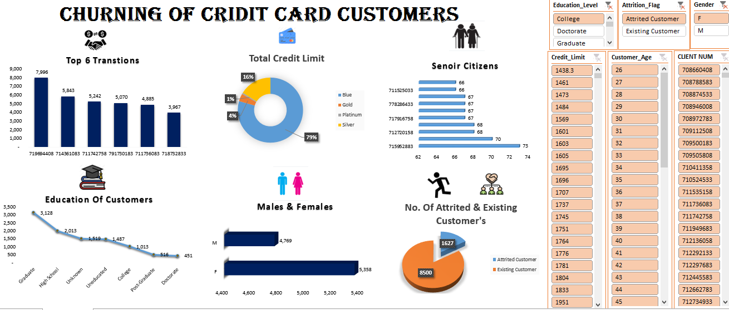
Dashboard

Slide 12
Link of the video
https://drive.google.com/file/d/1MW8S4tM5aIoR0OmIQFFQgHioSZu4Ggte/view?usp=sharing

Slide 13

Have a great day.

